Slide 1
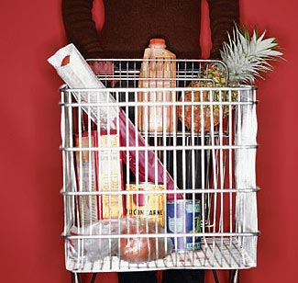


On-Demand Factory
August 04, 2004
IRI Enterprise Business Rules Solution

Slide 2
Agenda – Business Rules Solution
What Are Business Rules
Benefits of Business Rules
Business Rule Candidates at IRI
New Business Capabilities at IRI
ILOG Selection Criteria
ILOG References
Store Level QC Example Issues
Store Level QC Example ROI
Data Mart QC (JST/QC) Example ROI
Releasability Example ROI
Appendix
Notes:
Copyright © Information Resources, Inc. 2004. Confidential and proprietary.

Slide 3
What Are Business Rules
Business Rules are Statements of Complex Business Logic that Define or Constrain Corporate Activities
Example (From Store Level QC):
  Condition: There has been a decrease of 40% or more in total sales dollars, total number of UPC's, and total units as well as a 60% decrease in the number of top UPCs
  Decision: This store data could be a problem and should be examined before it is loaded

Slide 4
Benefits of Business Rules
Quickly Changeable to Deal with Volatile Business Issues or Changing Markets Without IT Programming Intervention
  Meet Changing Markets and Client Demands
  Meet Real World Changes (e.g., Daily Data, $100M Grocery Stores)
  Reduce Restatement and Reprocessing Costs Caused by Inflexible Systems
  Reduction of Error and Lateness Penalties Caused by Inflexible Systems
  Improved Data Quality Needed to Meet 100% Customer Satisfaction by Monitoring Different Aspects of Data Quality as Needed
Used to Capture Business Logic
  Turn Resource Expertise into an IRI Corporate Asset
  Single Source of Truth of Business Logic

Slide 5
Benefits of Business Rules (Cont.)
Maintained in an English Format Understood by the Business Analyst
  Quicker Development of New Systems because of the Testing and Implementation of Business Logic by the Business Analysts
  Less Effort Causing Reduction of Maintenance
Maintained in a Central Rule Repository and Run Within Many Applications Separate from the Programming Logic
  Centralized Management of Corporate Business Logic
  Reuse of Business Logic Across Multiple Applications
  Ability to Control Change at the Business Logic Level
Tied Directly to Business Objects
  Track Business Rule and Business Object Lineage

Slide 6
Business Rule Candidates at IRI
Store and UPC Level QC, QC Aggregation and QC SOP’s
  1,500 Rules (Derived from Program Logic and Documentation)
Geography and Panel Releasability
  1,200 Rules (Geography Only – Derived from Program Logic)
Contract/SLA Automation
  4,200 Rules (7,000 Contracts, 30 Rules/Contract – 98% Reusable – Derived from Actual Contracts)
Business Process Management
  Global Item Priority Engine (What to work on next)
  Item Queuing Engine (Rules for putting Items into Queues)
  Data Integration
Note: All of the above are estimates and approximations
Additional Candidates are in Appendix A

Slide 7
New Business Capabilities at IRI
Intelligent Monitoring & Tracking
  Create More Granular QC Checks by Store
  Tracking Specific Products for Specific Clients
  Pulling Specific Data for Quality Analysis and Monitoring
  Smart Factory Dashboard Monitoring System
Smart Data Lineage System
Platform Independent Authoring and Maintenance of Measures
Automatic Dynamic Building of ETL Jobs (Generative Job Creation thru out CODF and could extend to BPM, DI and VI)
Intelligent Aggregation of Source Data for QC (Appendix B)

Slide 8
ILOG Selection Criteria
Gartner Magic Quadrangle
  Upper Right Hand Quadrant
Meta Group
  Nearest Competition is Fair Isaac
  ILOG JRules more Scalable than Fair Isaac
  Suggestion to Use a Vendor that Has Other Products to Meet IRI Needs – ILOG has:
    Schedule Optimization
    Mathematical Optimization
    Configuration Optimization
One of the Possible IRI Solutions for Product Configuration
ILOG has Partnered with Ascential to Develop a DataStage Plug-in
JRules POC Running on a GRID using DataSynapse GridServer

Slide 9
ILOG References
Visa
  8 Million Records
  2400 Rules
  19.2 BILLION Rules Evaluated per Hour
Major Healthcare Insurance Provider
  3 Million Claims with 3 Lines per Claim
  2000 Rules Organized in 150 Rule Sets
  9 MILLION Rule Transactions Processed in 10 Hours
Credit Card Marketing Promotion Management
  48 Million Customer Records Processed per Month
  200 Business Rules
  78 THOUSAND Rule Firings per Second
  Integrated with Ab Initio ETL Data Pipe
Major Insurance Company
  IT Support and Maintenance went from 86% to 54% Using ILOG JRules Based Applications
Note: This Information is from ILOG – Needs to be Verified and Tested
Additional ILOG Information is in Appendix C & D

Slide 10
Store Level QC Example Issues
Information from Loch Rose and Jon Strauss
SAS Programs have been Written to Compensate for the Inflexibility of the Original C Programs
  PAIN: High Level Analytical Resources are Maintaining SAS Program
  PAIN REDUCTION: Business Rules are Maintained in an English Format Understood by the Business Analyst and can be Quickly Changed
Cannot Easily Change QC to meet Market, Vendor and World Changes
  PAIN: Causes Decrease In Data Quality which Causes Vendor Penalties
  PAIN REDUCTION: Business Rules are Quickly Changeable to Deal with Volatile Business Issues or Changing Markets Without IT Programming Intervention
Data Quality Trend Analysis Takes Too Long To Complete
  PAIN: Data Quality Trending Problems are Discovered Too Late
  PAIN REDUCTION: Business Rules are Maintained in an English Format Understood by the Business Analyst and can be put in place Quickly to Monitor Data Quality Trends

Slide 11
Store Level QC Example ROI
Source | Hours | $/Hr | Cost
Metrics dev. | 700 | 48 | 33,600
Rules dev. (Consultant) | 300 | 200 | 60,000
Decision dev. | 100 | 48 | 4,800
Development Cost | 1,100 |  | $98,400
ILOG Licenses |  |  | 450,000
Total Cost |  |  | $611,400
Source of Savings
Reduce 1 FTE currently required to operate SLQC |  |  | 20,000
Costs due to major failures: reruns, penalties (assumes 70% reduction of $495,000) |  |  | 346,500
ILOG Annual Maintenance |  |  | (67,500)
Total Annual Savings |  |  | $299,000
ILOG Software Payoff | 1.6 Years
Total Project Payoff | 2.0 Years
Note: Estimates are from Loch Rose and Jay Yusko

Slide 12
Data Mart QC (JST/QC) Example ROI

Slide 13
Releasability Example ROI

Slide 14
Appendix A: Business Rule Candidates at IRI
Missing Price Generator
ACV Estimation and Reconciliation of Multiple Sources
Maintenance of Retail Custom Categories (RCC)
Total Retail View (TRV) Factor Calculations for Wal*Mart
Setup and Application of Analytical Models
Work Order Optimization Engine
Security Decisions

Slide 15
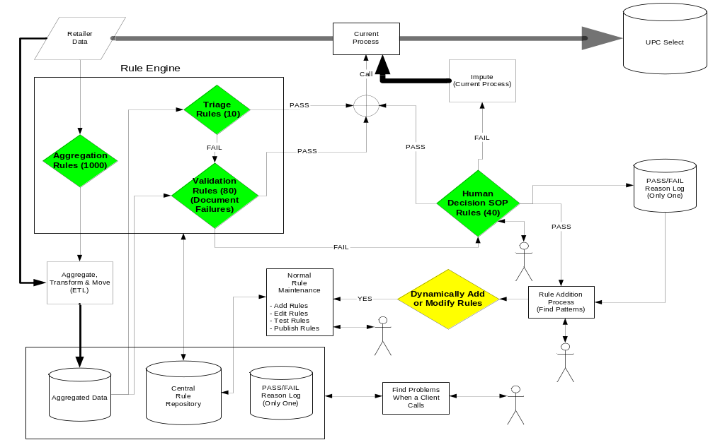
Appendix B: Store Level QC POC Architecture Example

Slide 16
Appendix C: ILOG The Company
Founded in 1987
Publicly Traded
$92.3 Million Revenue for FY03
25% Year Over Year Growth
45% of Income from Business Rules
Over 2,000 Customers
Over 300 ISV/OEM Partners
Sells in 30 Countries

Slide 17
Appendix D: ILOG JRule Features
Rule Authoring
  Natural Language Rules
  Rule Templates
  Web-Based Authoring
  Full Rule Debugging, Tracing and Validation
Central Repository
  Rule Repository in Oracle
  Where Used for Rules and Business Objects
  Version Control
  Search and Rule Reuse Capabilities
  Rule Publishing
Rule Engine Deployment
  J2EE, J2SE, Web Services
  Embeddable Rule Engine
  Hot Deployment of Business Rules
  Highly Scalable
Integration with Eclipse (Selected Java IDE for IRI)

